Slide 1
Biostatistics and Statistical Programming
Competency Methodology Validation
July 10, 2017

Slide 2
Agenda
Objective
Approach
Result
Excitement – en route
Way forward

Slide 3
Objective
Validate the proposed tool to:
Assess the overall health check for a larger implementation
Aid the roll-out across different clients
Identify any misses and amend if necessary
Identify if the SMEs had a consistent approach during implementation

Slide 4
Approach
Nominations from different projects
Setup meeting with the nominees to explain the self-assessment process
Seek self assessment – (No follow-up approach)
Setup meeting with managers to explain the manager-assessment process
Seek manager assessment – (No follow-up approach)
SME assessment (via interview)
2 SMEs simultaneous assessment
Alignment of the SME assessment to ensure consistency

Slide 5
Result

Slide 6
Nominations/ Self Assessment Received
Projects | Experience spread
 | E1 | E2 | E3 | E4 | Grand Total
Amgen | 2 |  |  |  | 2
Davita | 2 |  | 1 |  | 3
JnJ | 3 |  |  |  | 3
Pfizer | 1 | 1 | 1 |  | 3
Roche | 1 |  | 1 | 1 | 3
Sanofi | 1 |  | 1 | 2 | 4
Grand Total | 10 | 1 | 4 | 3 | 18
Data not received from Ferring
BI and GSK not included

Slide 7
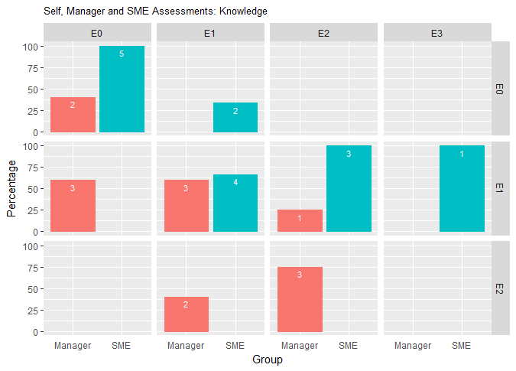
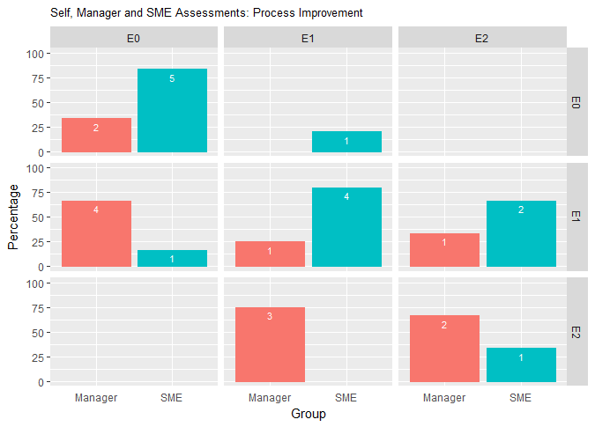
Pilot Results
Self Assessment: Overall Knowledge
Self Assessment: Process Improvement
Actual
Assessment

Slide 8
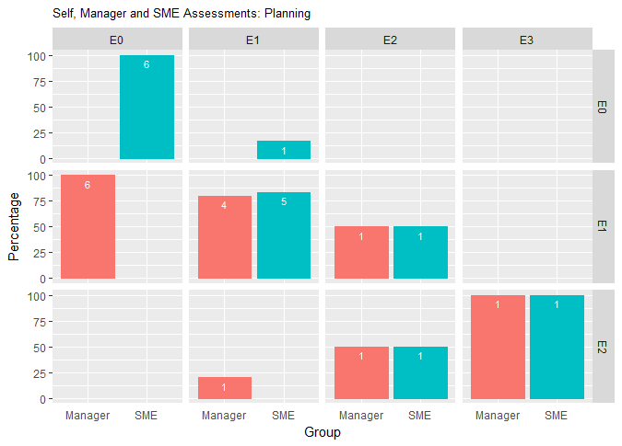
Pilot Results
Self Assessment: Planning
The sample data is not equally distributed among the experience ranges
SME and individual self assessment are more closer
Associates with lesser number of years of experience more self aware
Post discussion with SMEs the self assessments were updated by many
Managers and TLS need to be coached / trained before implementation
Need of overall grooming of the team to understand the pharma domain
Associates with higher years of experience need to expand their domain horizon and develop more self awareness
Overall all the associates are very well tuned to their projects and hence a need of exposure outside the projects is vital
Actual
Assessment

Slide 9

Excitement – en route

Slide 10
Implementation Motivation Consistency - mastery
Excitement- en route
Sessions to be conducted separately for Managers/ TLs and TMs
Seek Open feedback
Explanation of the larger goal
Alignment on the assessment between SMEs, Managers and Associates and Senior leaders
Continuous coaching
Be present in the moment / be available

Slide 11

Way Forward

Slide 12
Implementation Continuous process Autonomous with a purpose
Way Forward
Top – Down percolation
Only 2 assessments 1 manager and 1 self assessment
SME available for guidance
Coaching session for managers to be planned
Determine the frequency
Make it a part of the official process for career development for associates
Map to the larger goal of building a road map both for projects and overall TCS.
Demonstrate tangible benefits
New opportunities
Lateral movements

Slide 13
Appendix

Slide 14
Experience v/s Knowledge
Experience | Knowledge
 | E0 | E1 | E2 | E3 | Grand Total
E1 | 5 | 5 |  |  | 10
E2 |  |  | 1 |  | 1
E3 |  | 1 | 2 | 1 | 4
E4 |  | 1 | 2 |  | 3
Grand Total | 5 | 7 | 5 | 1 | 18
Self assessment
Experience | Knowledge
 | E0 | E1 | E2 | E3 | NA* | Grand Total
E1 | 2 | 6 |  |  | 2 | 10
E2 |  |  |  |  | 1 | 1
E3 |  |  | 3 |  | 1 | 4
E4 |  | 1 | 2 |  |  | 3
Grand Total | 2 | 7 | 5 |  | 4 | 18
Manager assessment
* NA → Not Assessed
Experience | Knowledge
 | E0 | E1 | E2 | E3 | NA* | Grand Total
E1 | 7 | 2 |  |  | 1 | 10
E2 |  |  |  |  | 1 | 1
E3 |  | 3 |  |  | 1 | 4
E4 |  | 3 |  |  |  | 3
Grand Total | 7 | 8 |  |  | 3 | 18
SME assessment
* NA → Not Assessed

Slide 15
Experience v/s Process Improvement
Experience | Process Improvement
 | E0 | E1 | E2 | E3 | Grand Total
E1 | 7 | 3 |  |  | 10
E2 |  |  |  | 1 | 1
E3 |  | 2 | 2 |  | 4
E4 |  | 1 | 2 |  | 3
Grand Total | 7 | 6 | 4 | 1 | 18
Self assessment
Experience | Process Improvement
 | E0 | E1 | E2 | E3 | NA* | Grand Total
E1 | 2 | 6 |  |  | 2 | 10
E2 |  |  |  |  | 1 | 1
E3 |  |  | 3 |  | 1 | 4
E4 |  | 1 | 2 |  |  | 3
Grand Total | 2 | 7 | 5 |  | 4 | 18
Manager assessment
* NA → Not Assessed
Experience | Process Improvement
 | E0 | E1 | E2 | E3 | NA* | Grand Total
E1 | 7 | 2 |  |  | 1 | 10
E2 |  |  |  |  | 1 | 1
E3 |  | 3 |  |  | 1 | 4
E4 |  | 2 | 1 |  |  | 3
Grand Total | 7 | 7 | 1 |  | 3 | 18
SME assessment
* NA → Not Assessed

Slide 16
Experience v/s Planning
Experience | Planning
 | E0 | E1 | E2 | E3 | Grand Total
E1 | 6 | 4 |  |  | 10
E2 |  |  |  | 1 | 1
E3 |  | 2 | 2 |  | 4
E4 |  | 1 | 1 | 1 | 3
Grand Total | 6 | 7 | 3 | 2 | 18
Self assessment
Experience | Planning
 | E0 | E1 | E2 | E3 | NA* | Grand Total
E1 |  | 8 |  |  | 2 | 10
E2 |  |  |  |  | 1 | 1
E3 |  | 2 | 1 |  | 1 | 4
E4 |  | 1 | 2 |  |  | 3
Grand Total |  | 11 | 3 |  | 4 | 18
Manager assessment
* NA → Not Assessed
Experience | Planning
 | E0 | E1 | E2 | E3 | NA* | Grand Total
E1 | 7 | 2 |  |  | 1 | 10
E2 |  |  |  |  | 1 | 1
E3 |  | 3 |  |  | 1 | 4
E4 |  | 1 | 2 |  |  | 3
Grand Total | 7 | 6 | 2 |  | 3 | 18
SME assessment
* NA → Not Assessed

Slide 17
Overall Knowledge, Process Improvement and Planning comparison
Knowledge | Self | Manager | SME
E0 | 5 | 2 | 7
E1 | 7 | 7 | 8
E2 | 5 | 5 | 0
E3 | 1 | 0 | 0
NA |  | 4 | 3
Process Improvement | Self | Manager | SME
E0 | 7 | 2 | 7
E1 | 6 | 6 | 6
E2 | 3 | 5 | 1
E3 | 1
NA |  | 4 | 3
Planning | Self | Manager | SME
E0 | 6 | 10 | 7
E1 | 6 | 3 | 5
E2 | 3 |  | 2
E3 | 2 | 0 | 0
NA | 0 | 4 | 3

Slide 18
Measure of Concordance @ Knowledge
Self Assessment |  | Manager
 |  | E0 | E1 | E2 | E3 | E4 | NA
E0 | 5 | 2 | 3 | 0 | 0 | 0 | 0
E1 | 7 | 0 | 3 | 2 | 0 | 0 | 2
E2 | 5 | 0 | 1 | 3 | 0 | 0 | 1
E3 | 1 | 0 | 0 | 0 | 0 | 0 | 1
E4 | 0 | 0 | 0 | 0 | 0 | 0 | 0
NA | 0 | 0 | 0 | 0 | 0 | 0 | 0
Self Assessment |  | Manager
 |  | E0 | E1 | E2 | E3 | E4 | NA
E0 | 5 | 40% | 60% | 0% | 0% | 0% | 0%
E1 | 7 | 0% | 43% | 29% | 0% | 0% | 29%
E2 | 5 | 0% | 20% | 60% | 0% | 0% | 20%
E3 | 1 | 0% | 0% | 0% | 0% | 0% | 100%
E4 | 0 | NA | NA | NA | NA | NA | NA
NA | 0 | NA | NA | NA | NA | NA | NA
Self Assessment |  | SME
 |  | E0 | E1 | E2 | E3 | E4 | NA
E0 | 5 | 5 | 0 | 0 | 0 | 0 | 0
E1 | 7 | 2 | 4 | 0 | 0 | 0 | 1
E2 | 5 | 0 | 3 | 0 | 0 | 0 | 2
E3 | 1 | 0 | 1 | 0 | 0 | 0 | 0
E4 | 0 | 0 | 0 | 0 | 0 | 0 | 0
NA | 0 | 0 | 0 | 0 | 0 | 0 | 0
Self Assessment |  | SME
 |  | E0 | E1 | E2 | E3 | E4 | NA
E0 | 5 | 100% | 0% | 0% | 0% | 0% | 0%
E1 | 7 | 29% | 57% | 0% | 0% | 0% | 14%
E2 | 5 | 0% | 60% | 0% | 0% | 0% | 40%
E3 | 1 | 0% | 100% | 0% | 0% | 0% | 0%
E4 | 0 | NA | NA | NA | NA | NA | NA
NA | 0 | NA | NA | NA | NA | NA | NA

Slide 19
Measure of Concordance @ Process Improvement
Self Assessment |  | Manager
 |  | E0 | E1 | E2 | E3 | E4 | NA
E0 | 6 | 2 | 4 | 0 | 0 | 0 | 0
E1 | 6 | 0 | 1 | 3 | 0 | 0 | 2
E2 | 4 | 0 | 1 | 2 | 0 | 0 | 1
E3 | 1 | 0 | 0 | 0 | 0 | 0 | 1
E4 | 0 | 0 | 0 | 0 | 0 | 0 | 0
NA | 1 | 0 | 1 | 0 | 0 | 0 | 0
Self Assessment |  | Manager
 |  | E0 | E1 | E2 | E3 | E4 | NA
E0 | 6 | 33% | 67% | 0% | 0% | 0% | 0%
E1 | 6 | 0% | 17% | 50% | 0% | 0% | 33%
E2 | 4 | 0% | 25% | 50% | 0% | 0% | 25%
E3 | 1 | 0% | 0% | 0% | 0% | 0% | 100%
E4 | 0 | NA | NA | NA | NA | NA | NA
NA | 1 | 0% | 100% | 0% | 0% | 0% | 0%
Self Assessment |  | SME
 |  | E0 | E1 | E2 | E3 | E4 | NA
E0 | 6 | 5 | 1 | 0 | 0 | 0 | 0
E1 | 6 | 1 | 4 | 0 | 0 | 0 | 1
E2 | 4 | 0 | 2 | 1 | 0 | 0 | 1
E3 | 1 | 0 | 0 | 0 | 0 | 0 | 1
E4 | 0 | 0 | 0 | 0 | 0 | 0 | 0
NA | 1 | 1 | 0 | 0 | 0 | 0 | 0
Self Assessment |  | SME
 |  | E0 | E1 | E2 | E3 | E4 | NA
E0 | 6 | 83% | 17% | 0% | 0% | 0% | 0%
E1 | 6 | 17% | 67% | 0% | 0% | 0% | 17%
E2 | 4 | 0% | 50% | 25% | 0% | 0% | 25%
E3 | 1 | 0% | 0% | 0% | 0% | 0% | 100%
E4 | 0 | NA | NA | NA | NA | NA | NA
NA | 1 | 100% | 0% | 0% | 0% | 0% | 0%

Slide 20
Measure of Concordance @ Planning
Self Assessment |  | Manager
 |  | E0 | E1 | E2 | E3 | E4 | NA
E0 | 6 | 0 | 6 | 0 | 0 | 0 | 0
E1 | 7 | 0 | 4 | 1 | 0 | 0 | 2
E2 | 3 | 0 | 1 | 1 | 0 | 0 | 1
E3 | 2 | 0 | 0 | 1 | 0 | 0 | 1
E4 | 0 | 0 | 0 | 0 | 0 | 0 | 0
NA | 0 | 0 | 0 | 0 | 0 | 0 | 0
Self Assessment |  | Manager
 |  | E0 | E1 | E2 | E3 | E4 | NA
E0 | 6 | 0% | 100% | 0% | 0% | 0% | 0%
E1 | 7 | 0% | 57% | 14% | 0% | 0% | 29%
E2 | 3 | 0% | 33% | 33% | 0% | 0% | 33%
E3 | 2 | 0% | 0% | 50% | 0% | 0% | 50%
E4 | 0 | NA | NA | NA | NA | NA | NA
NA | 0 | NA | NA | NA | NA | NA | NA
Self Assessment |  | SME
 |  | E0 | E1 | E2 | E3 | E4 | NA
E0 | 6 | 6 | 0 | 0 | 0 | 0 | 0
E1 | 7 | 1 | 5 | 0 | 0 | 0 | 1
E2 | 3 | 0 | 1 | 1 | 0 | 0 | 1
E3 | 2 | 0 | 0 | 1 | 0 | 0 | 1
E4 | 0 | 0 | 0 | 0 | 0 | 0 | 0
NA | 0 | 0 | 0 | 0 | 0 | 0 | 0
Self Assessment |  | SME
 |  | E0 | E1 | E2 | E3 | E4 | NA
E0 | 6 | 100% | 0% | 0% | 0% | 0% | 0%
E1 | 7 | 14% | 71% | 0% | 0% | 0% | 14%
E2 | 3 | 0% | 33% | 33% | 0% | 0% | 33%
E3 | 2 | 0% | 0% | 50% | 0% | 0% | 50%
E4 | 0 | NA | NA | NA | NA | NA | NA
NA | 0 | NA | NA | NA | NA | NA | NA

